Slide 1
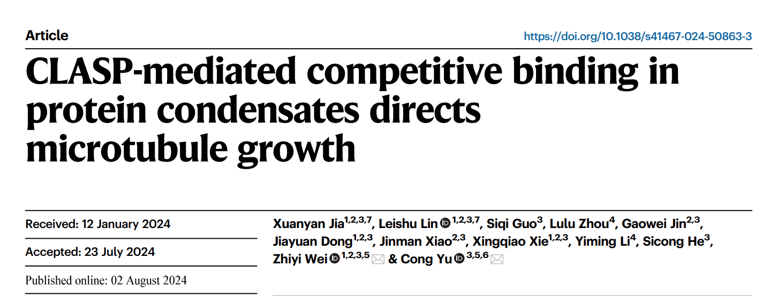
Li Liuyu
2024.9.22

Slide 2
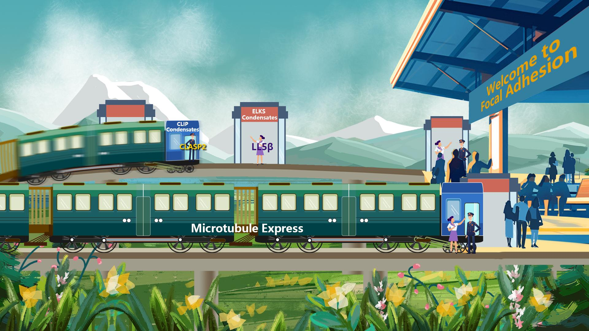
Navigation and Targeting of MT
Notes:
CLASP是导航员，和谁打招呼，MT就去谁那

Slide 3
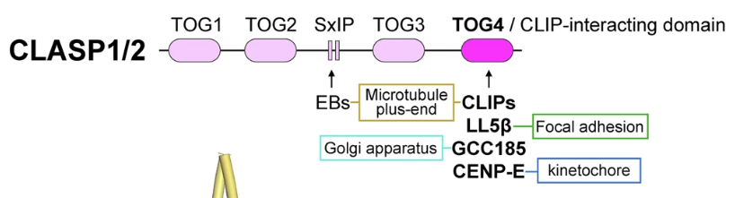
Main Character - CLASP
CLASP (CLIP-associated proteins)
Locate at MT plus end, maintain MT growth
Its TOG4 domain interacts with different proteins to regulate the localization of MT in various cellular compartments
Notes:
肿瘤过表达基因 （TOG） 细胞质接头蛋白（CLIP） CLIP相关蛋白（CLASP）末端结合蛋白 （EBs） plus 末端示踪蛋白 （+TIP）
TOG123结构完全相同，为12个α-helix，而TOG4的第12个helix为3（10）helix

Slide 4
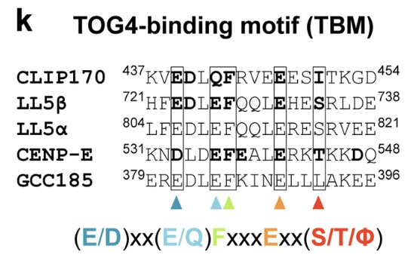
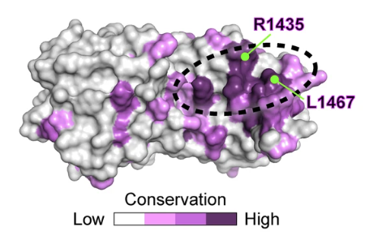
Common Binding Domain – TBM
TBM (TOG4-binding motif)
Proteins containing TBMs show the propensity to form condensates

Slide 5
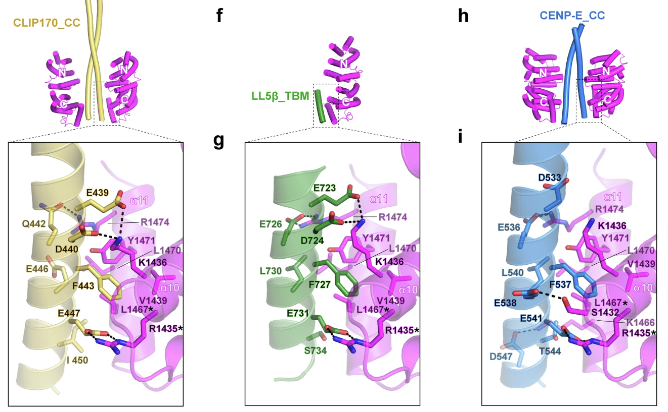
Structural Analysis of Interactions
L1467-F443
-F727
-F537
R1435-E447
-E731
-E541

Slide 6
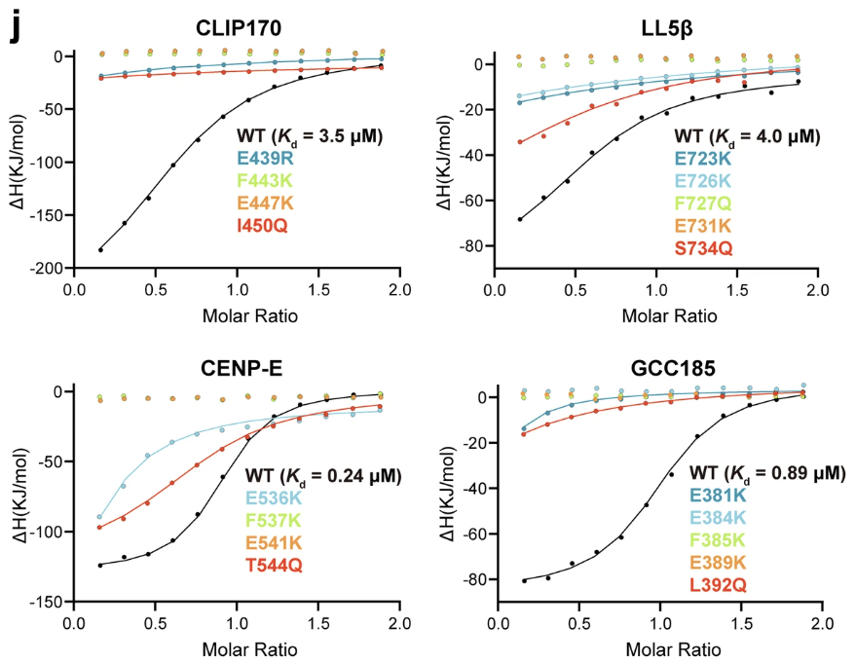
E and F play key roles in interactions
Notes:
突变掉TBM关键部位的E或F → 蛋白失去与CLASP的结合能力

Slide 7
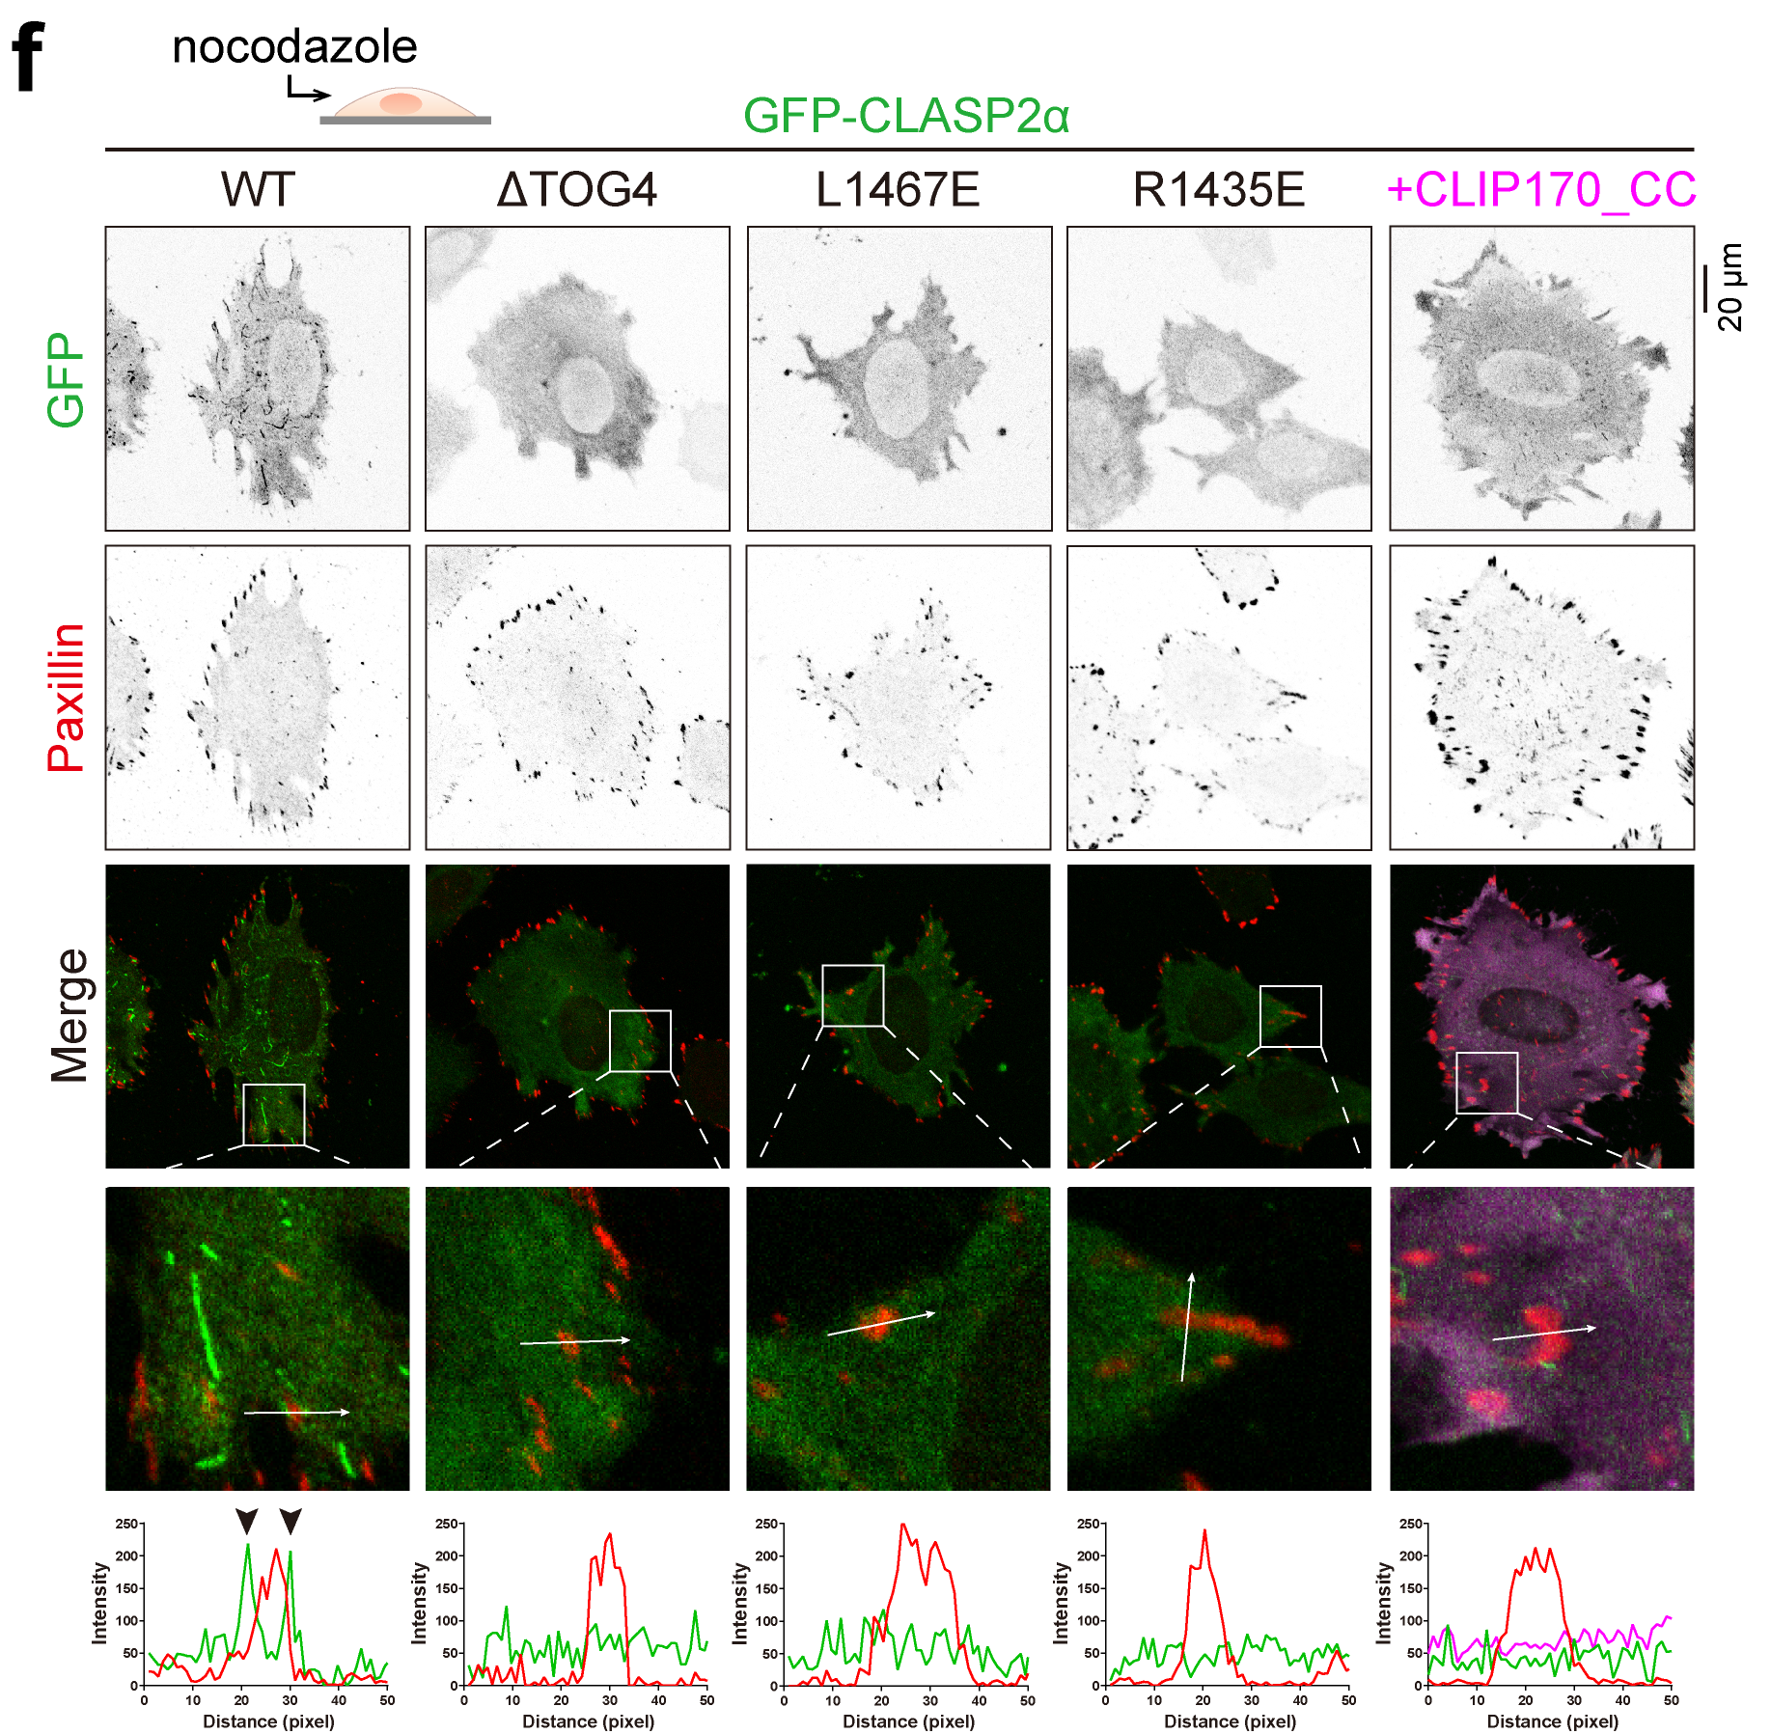
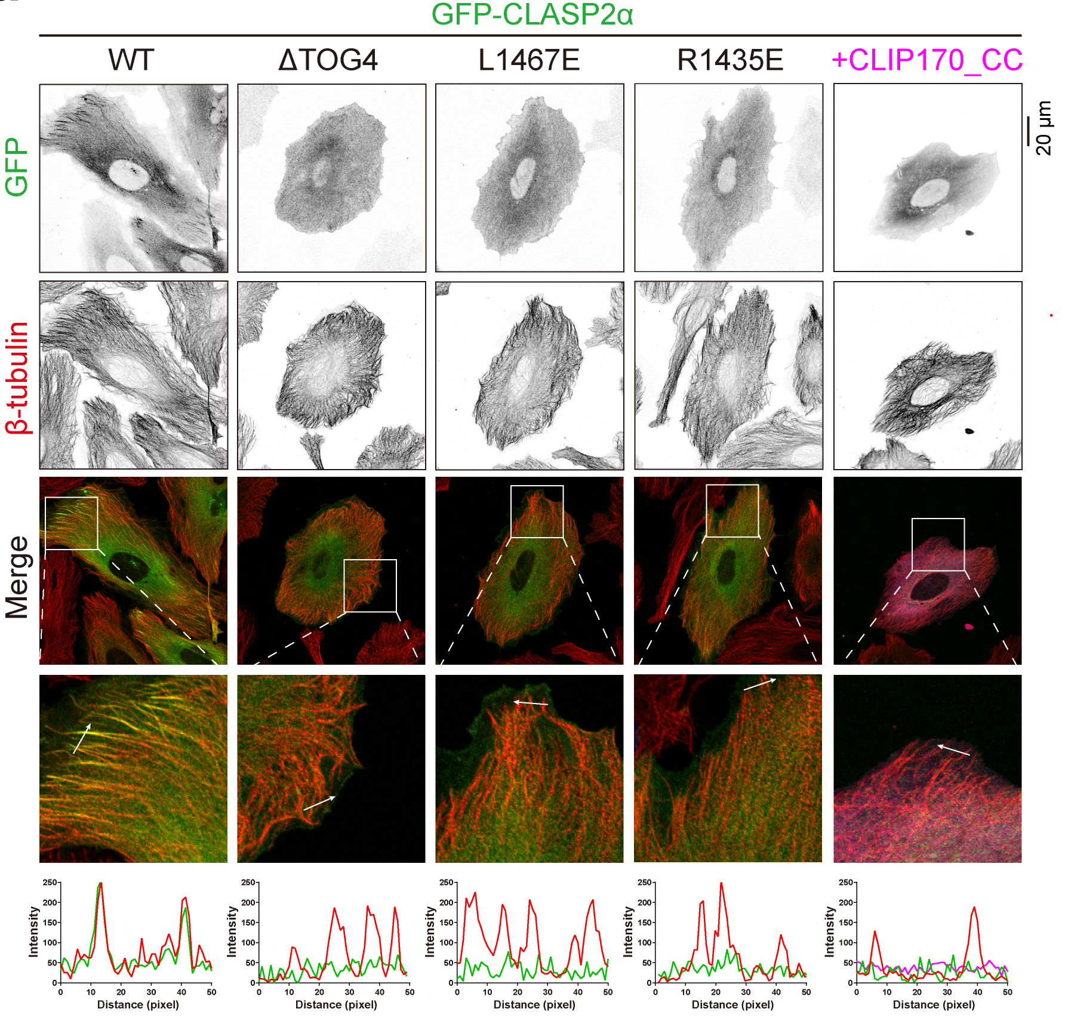
TOG4/TBM interaction is essential for CLASP2 targeting in cells
Notes:
TOG/TBM相互作用被突变阻断后，MT与CLASP2的共定位消失，说明CLASP2不能再引导MT生长

Slide 8
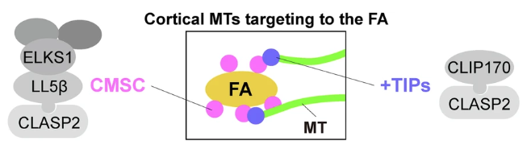
ELKS1 and LL5β recruit CLASP2 to FA
CMSC: cortical MT stabilizing complex
ELKS1 may accumulate LL5β and CLASP2 via LLPS
Notes:
皮质 MT 稳定复合物 （CMSC）
ELKS1 是一种富含卷曲螺旋的支架蛋白，主要参与神经元突触功能和胞吐过程，也参与细胞骨架和微管的调控。
LL5β 是位于细胞膜上的一种钙粘附相关蛋白，主要与细胞极性和微管锚定相关。它在调节微管附着和稳定性中起重要作用，特别是在细胞膜的特定区域如基质粘附斑（focal adhesions）附近。

Slide 9
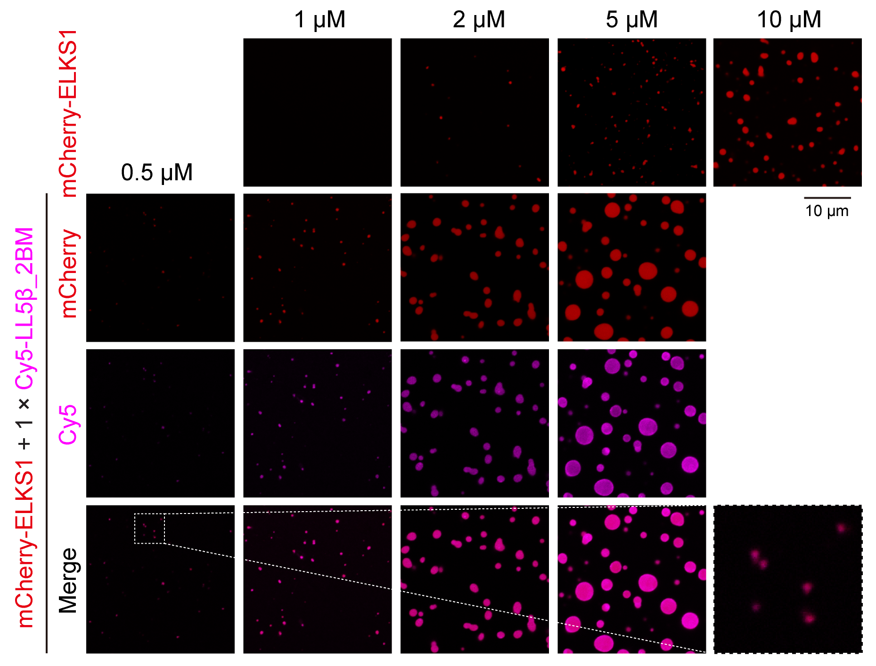
ELKS1 co-phase separates with LL5β
Notes:
ELKS1可以单独形成phase，但需要较高浓度；加入LL5β后，促进了condensate的形成；
且通过荧光可看出，两个蛋白是共定位的，说明是共同形成phase（因为先前研究已表明ELKS倾向于与可以相互作用的蛋白共同形成phase）

Slide 10
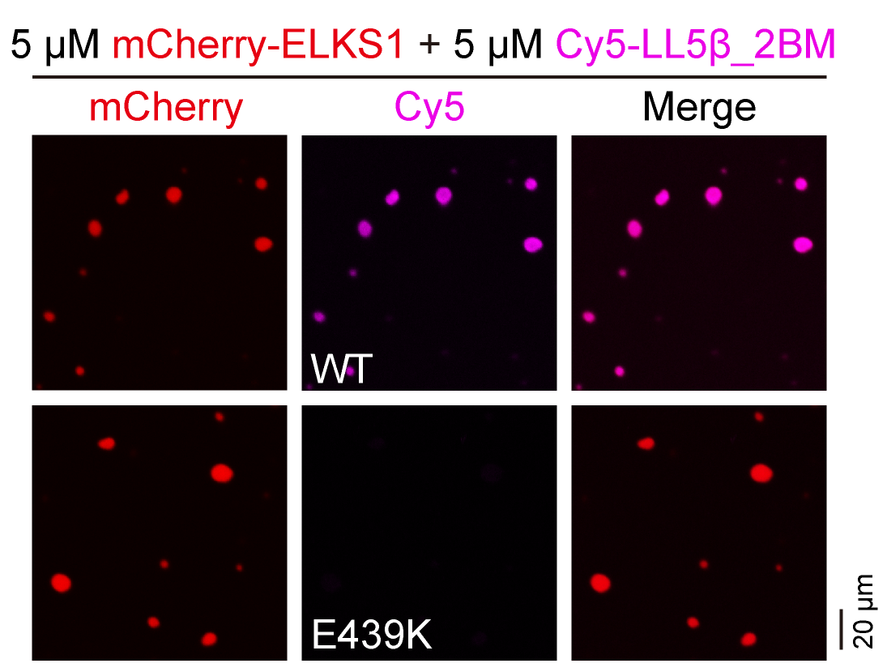
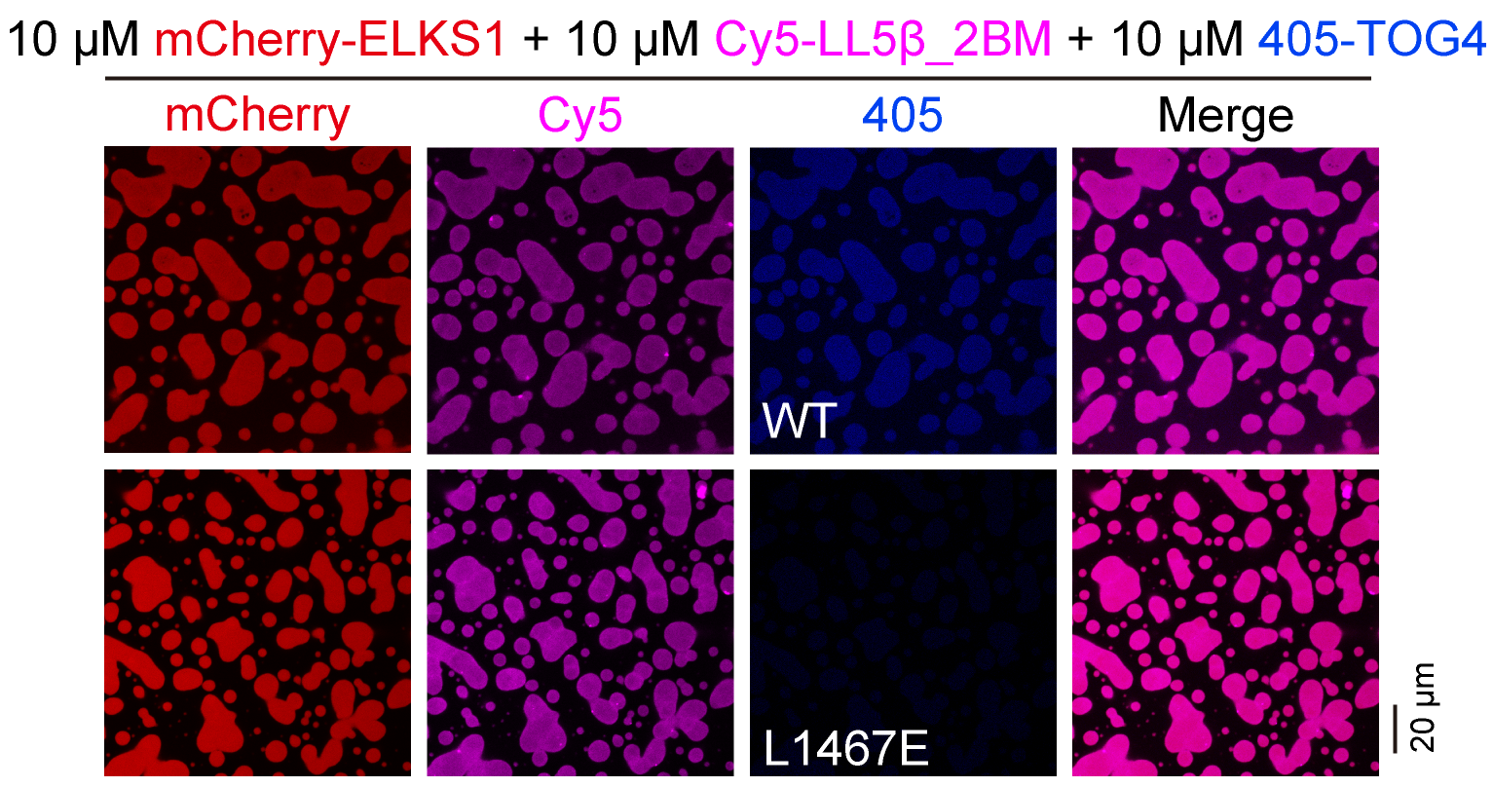
ELKS1 co-phase separates with LL5β in the recruitment of CLASP2 to the FA vicinity
Notes:
突变哪个，就是看哪个能否共同形成phase
WT是共定位，突变后就失去共定位，说明什么？还没搞懂

Slide 11
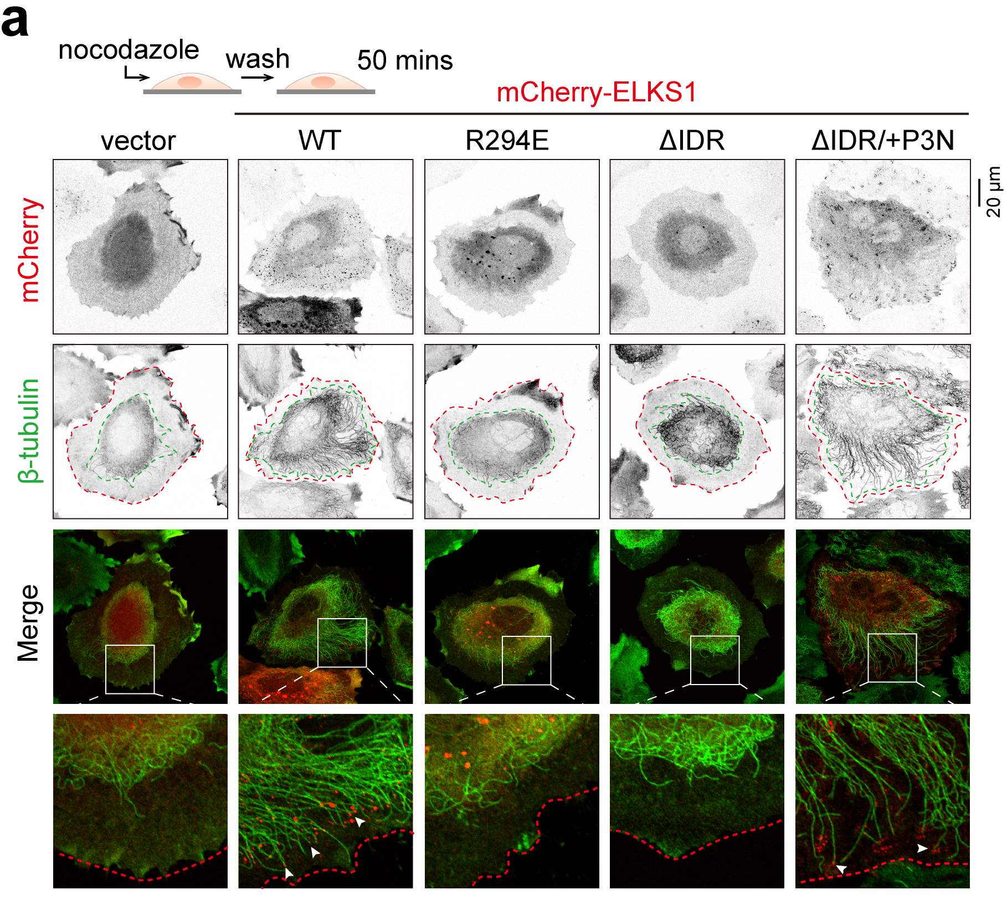
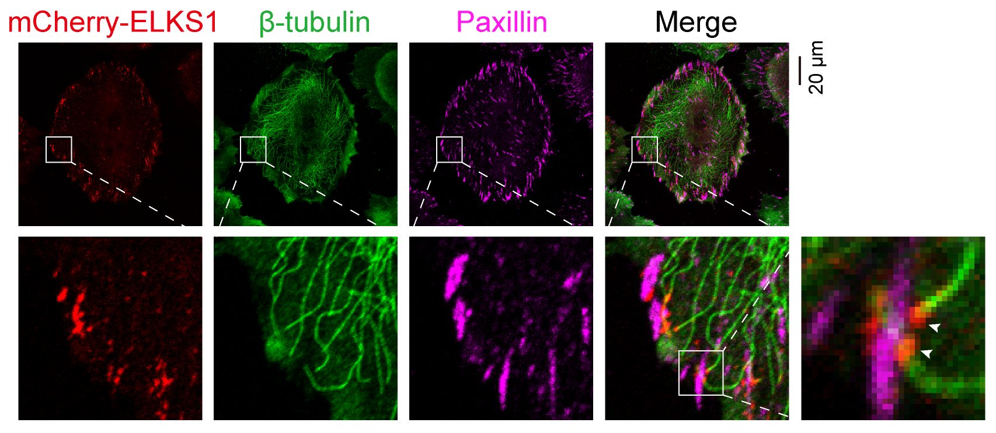
CLASP2 accumulation in ELKS1 and CLIP170 condensates is required for cortical MT targeting
ELKS1 co-phase separates with LL5β in the recruitment of CLASP2 to the FA vicinity.
LL5β accumulates in the ELKS1 condensate by binding to ELKS1 and consequently recruits CLASP2 into condensates.
Notes:
IDR：N端内在无序区 P3N：Par3的N末端结构域，可使蛋白具有LLPS的能力
ELKS1与CLASP2在细胞皮层的FA处发生共定位，从而引导MT向皮层延伸

Slide 12
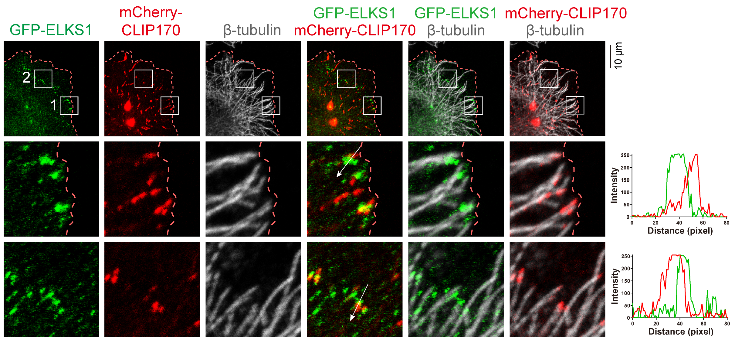
CLASP2 accumulation in ELKS1 and CLIP170 condensates is required for cortical MT targeting
CLIP170 also forms condensates and contacts with ELKS1 condensates
Notes:
CLIP170也能发生LLPS，且观察到CLIP170与ELKS的凝聚体有黏附现象
但到目前为止，仍然无法解释不同的具有TBM的蛋白与CLASP2的竞争结合作用与这种现象有何联系

Slide 13
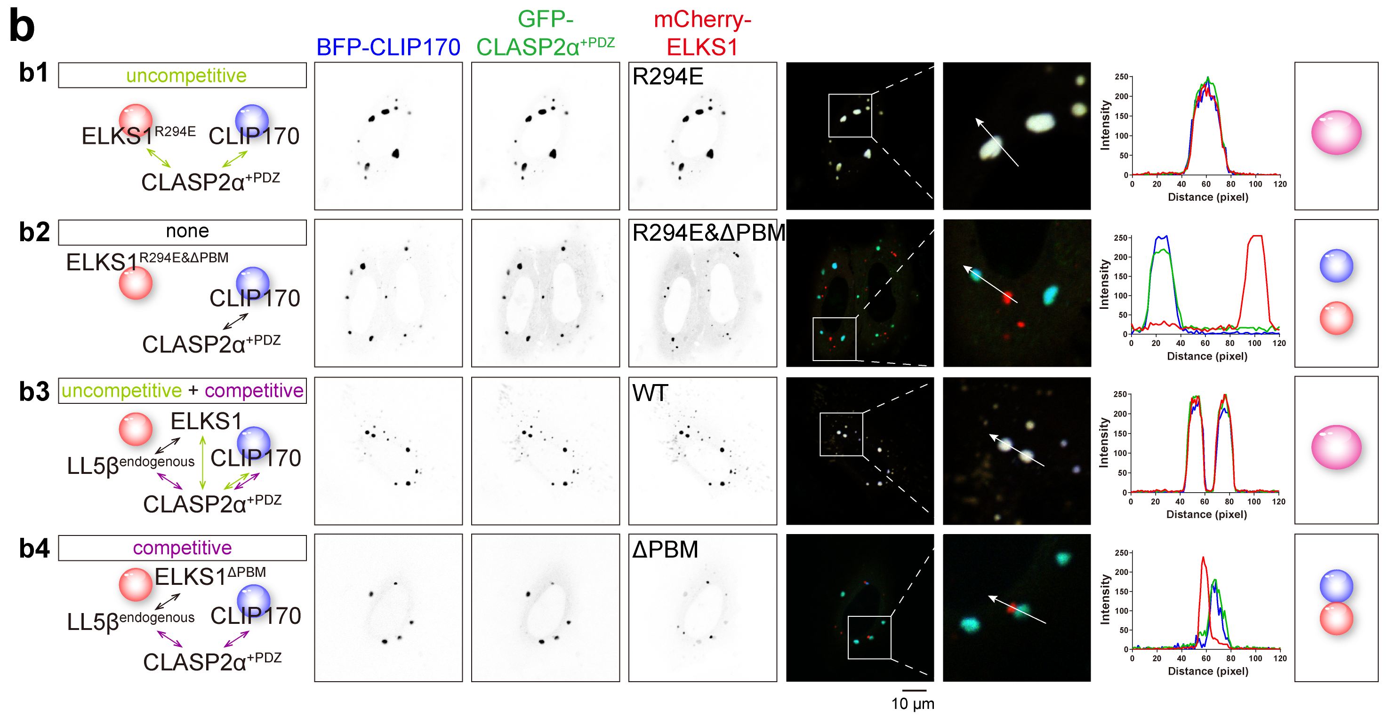
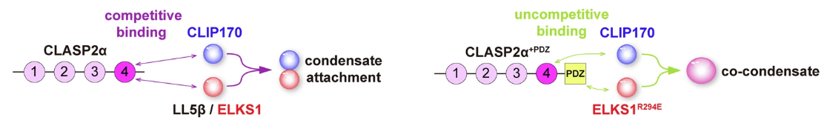
Competitive binding to accumulated CLASP2 mediates the stable contact between condensates
Notes:
“如何在特定站停靠”
但是为什么condensate融合了就不利于MT生长定位？也许是融合了不好分开，但论文中并未证明，作者也称证明难度较大。

Slide 14
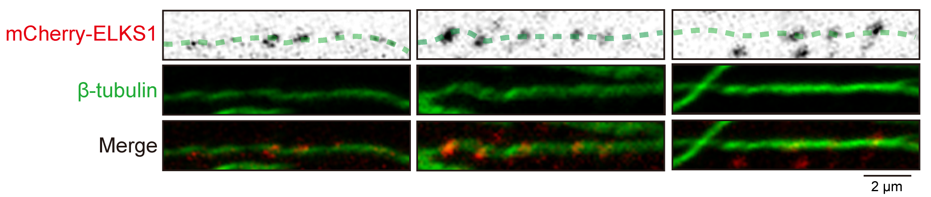
ELKS1 condensates distal to the cell edge may play a role in navigating MT growth towards the cell edge
The path of MTs often overlapped with several ELKS1 condensates in a row, indicating that the ELKS1 condensates distal to the cell edge may play a role in navigating MT growth towards the cell edge.
3
Notes:
“如何离站，继续行驶”

Slide 15
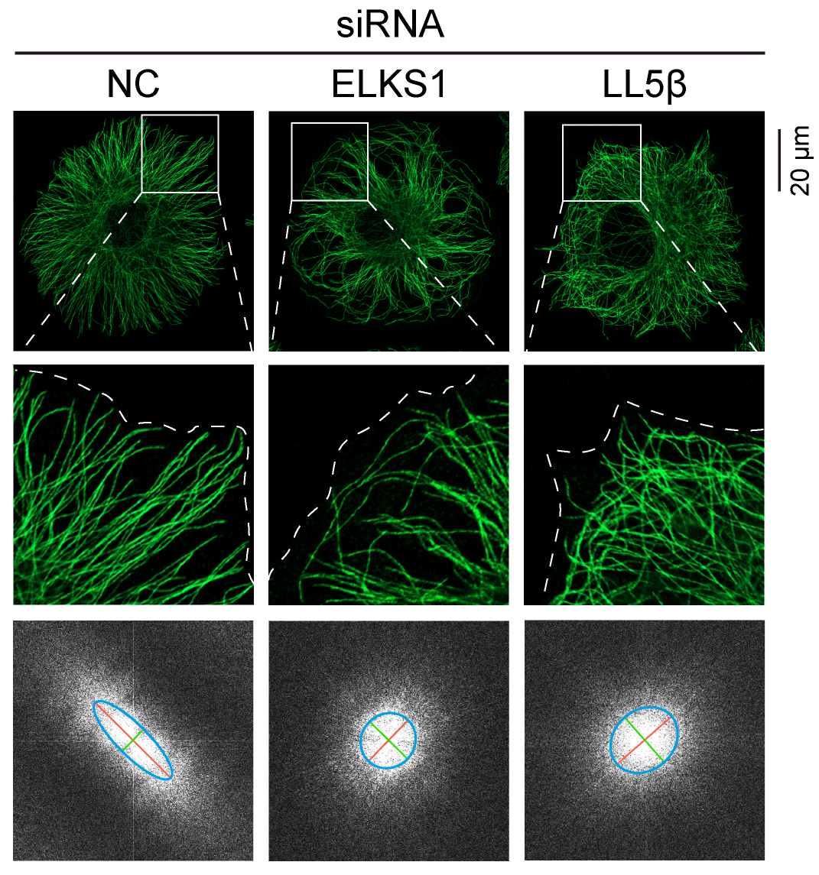
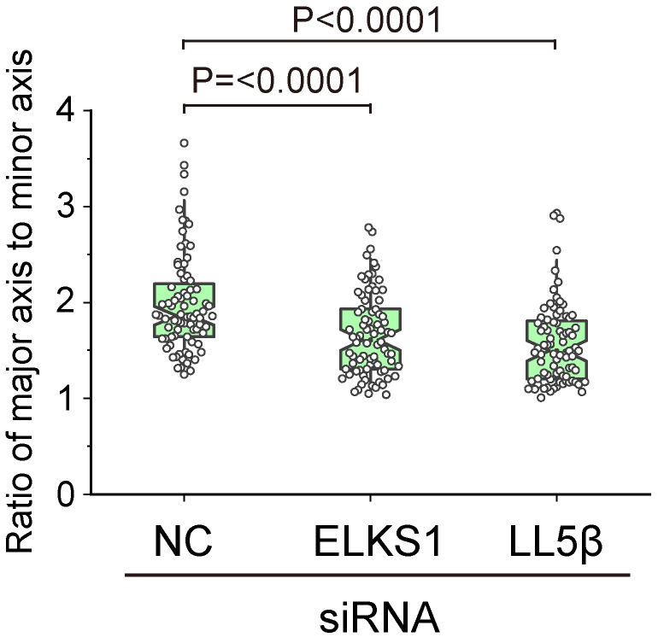
ELKS1 condensates distal to the cell edge may play a role in navigating MT growth towards the cell edge
anisotropic distribution → isotropic distribution
Notes:
将二维傅里叶变换应用于细胞外围的 MT 分布模式, 发现与与细胞外围具有各向异性分布的典型 MT 放射状组织不同，ELKS1或LL5β的敲低导致皮质 MT 杂乱无章，具有各向同性分布的趋势

Slide 16
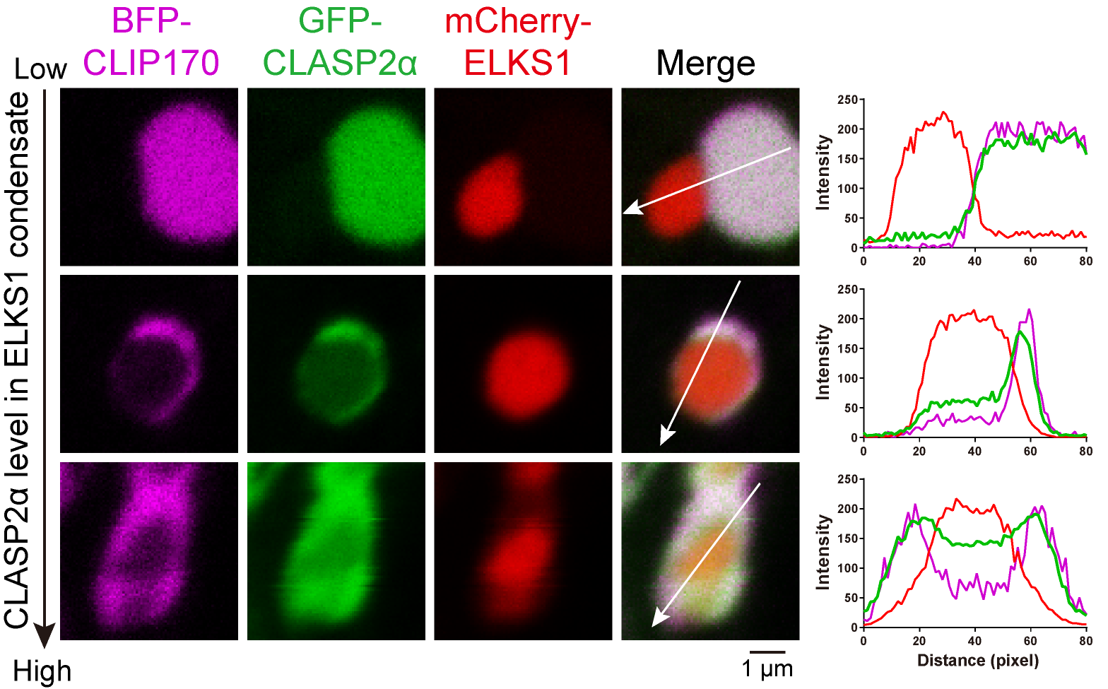
How to regulate the contact and detachment of MT plus end and ELKS1 condensates?
Given: a high level of CLASP2 is required for the stable contact between the CLIP170 and ELKS1 condensates
To find a mechanism that regulates CLASP2 levels
Notes:
CLIP170 和 ELKS1 凝聚物之间的稳定接触需要高水平的 CLASP2，因此可以通过降低 ELKS1 冷凝水中的 CLASP2 水平来实现分离。

Slide 17
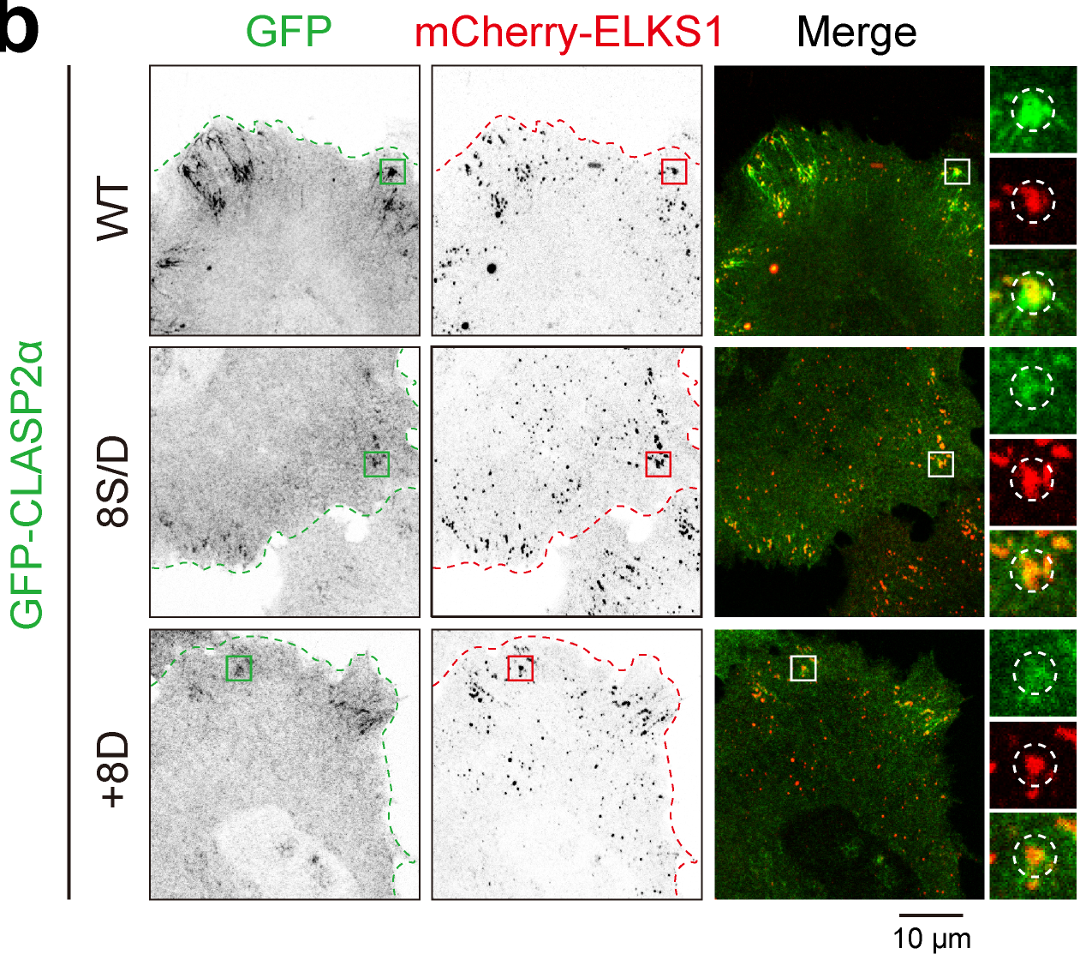
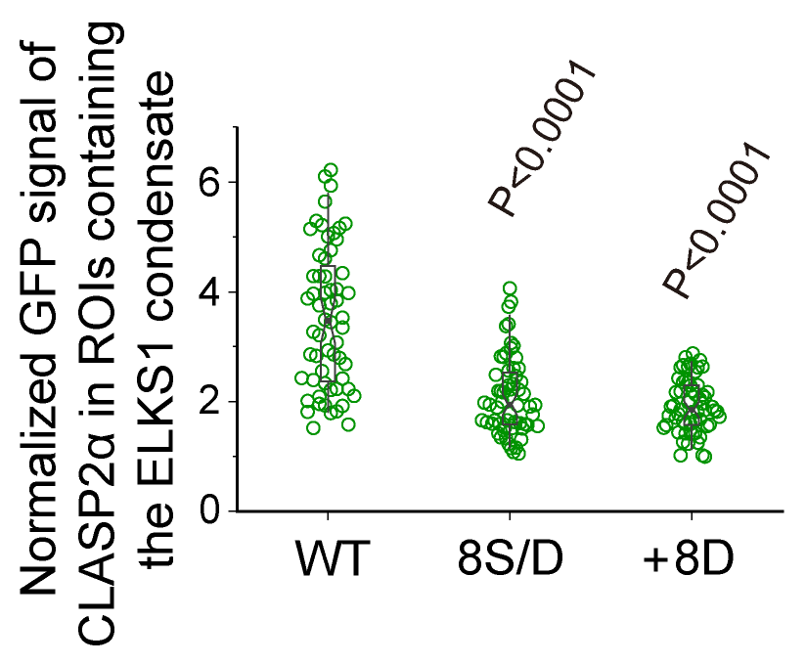
Phosphorylation of CLASP2 controls the detachment of MT plus end from ELKS1 condensate for the directional growth of MTs
Given: 1. CLASPs can be phosphorylated by GSK3β
2. Phosphomimetic mutant of CLASP2 leads to directionless MT growth
Inference: Phosphorylation of CLASP2 may inhibit its accumulation in the ELKS1 phase
Notes:
“如何离站，继续行驶”

Slide 18
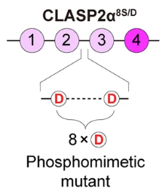
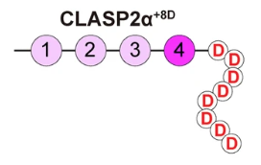
Phosphorylation of CLASP2 controls the detachment of MT plus end from ELKS1 condensate for the directional growth of MTs
Charge-mediated prevention
CLASP2 level
However, CLASP2^{8S/D} still accumulated in the CLIP170 condensate with a normal level, which indicates that the phosphorylation-dependent inhibition of CLASP2 accumulation in the condensed phase is selective.
Notes:
电荷介导的阻止 CLASP2 进入 ELKS1 的phase。
值得注意的是，CLASP2^{8S/D}仍然积累在胞质或 MT 末端的 CLIP170 phase中，其水平与WT中的相当。这表明 CLASP2 在phase中的磷酸化依赖性抑制是选择性的。

Slide 19
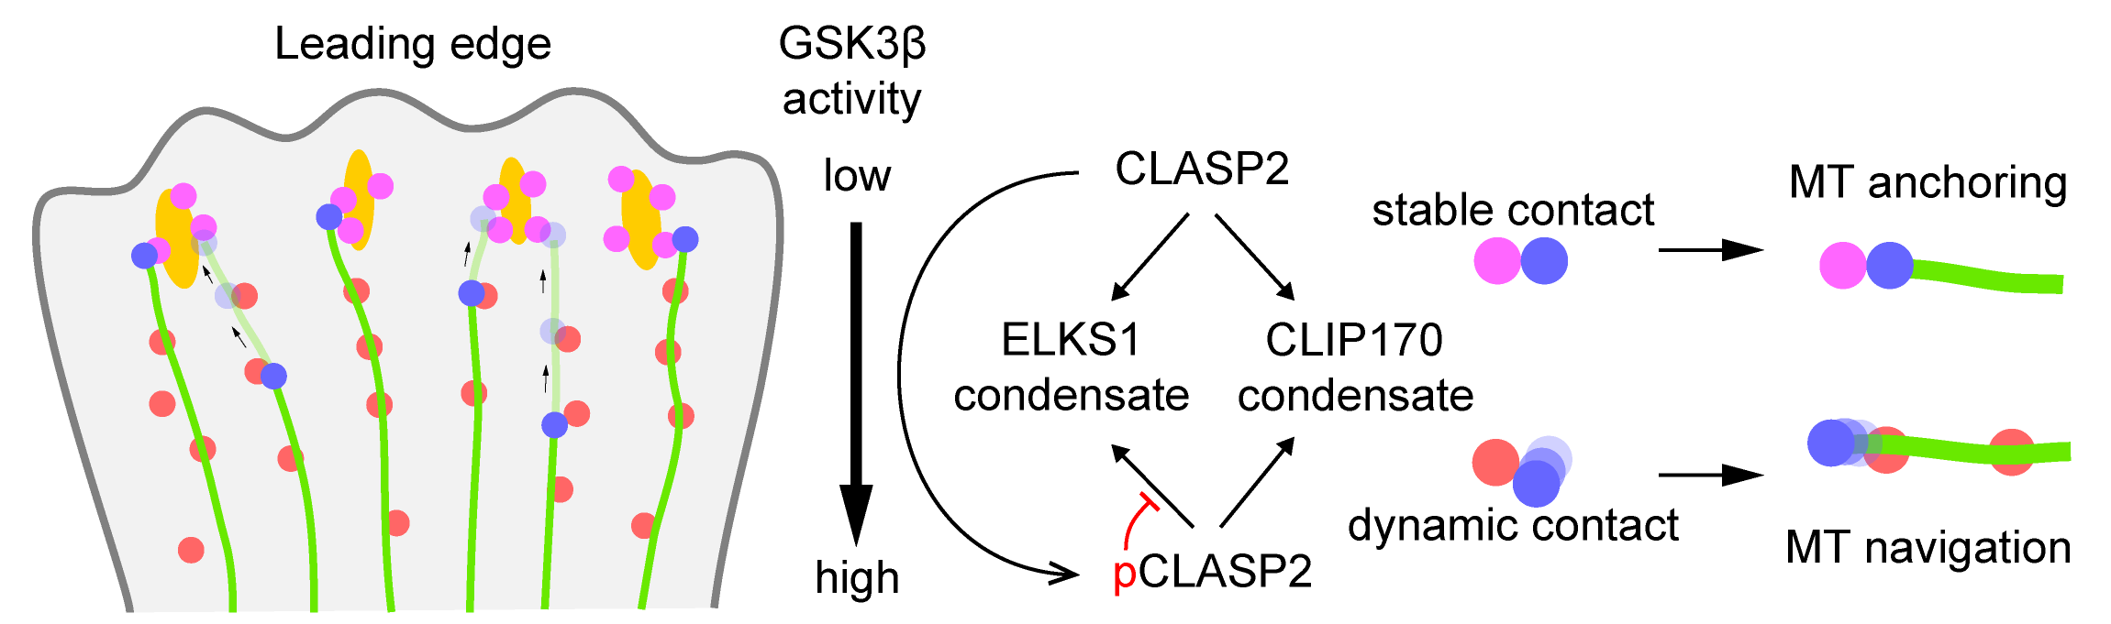
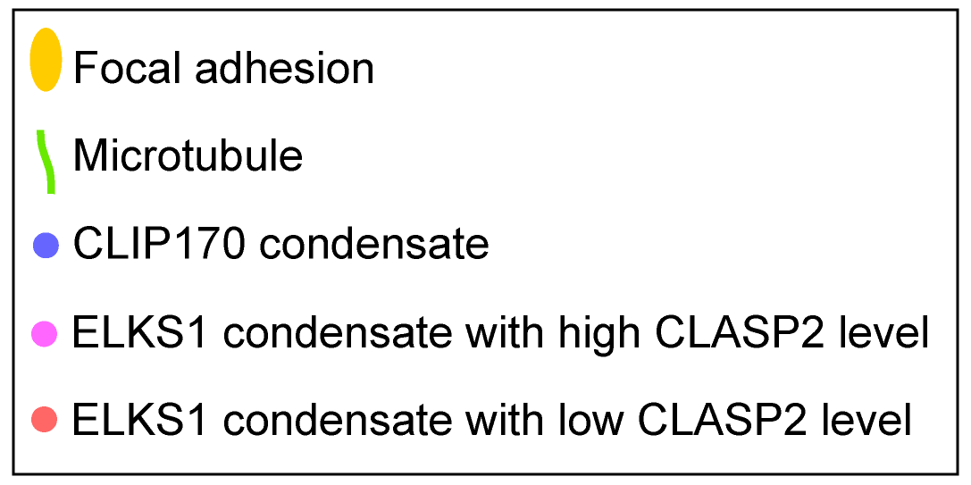
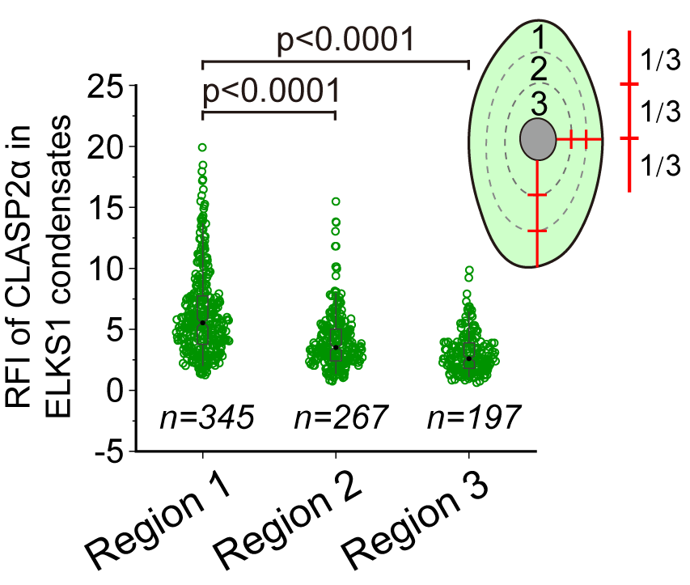
Phosphorylation of CLASP2 controls the detachment of MT plus end from ELKS1 condensate for the directional growth of MTs
Cell edge: low GSK3β – high CLASP2 – stable contact – MT anchoring
Cell interior: high GSK3β – low CLASP2 – dynamic contact – MT navigation
Notes:
至此，CLASP2介导的蛋白质凝聚物竞争性结合指导微管生长的机制就解释清楚了。

Slide 20
QUESTIONS?

Slide 21
THANKS FOR LISTENING

